Slide 1

Probability and Statistics
Han Min(hanm@bjut.edu.cn)
Office：3414 The Second Experimental Building
College of Applied Sciences
Beijing University of Technology
100124, Beijing P. R. China

Slide 2
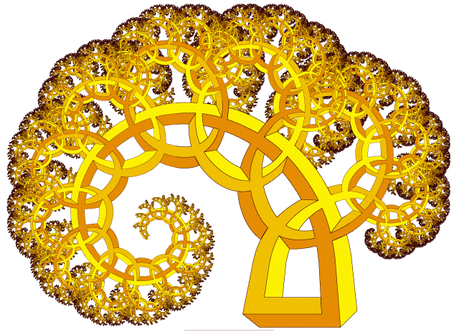
Chapter 7. Parameter Estimation
7.1 Point Estimation
7.2 Evaluation Standard for Estimations
7.3 Interval Estimation

Slide 3
Contents
7.3 Interval Estimation
Confidence intervals for the mean
of a Normal Distribution
7.3.1
Confidence intervals for the variance
of a Normal Distribution
7.3.2
Confidence intervals of two Normal Distributions
Confidence intervals of two Normal Distributions
7.3.3

Slide 4


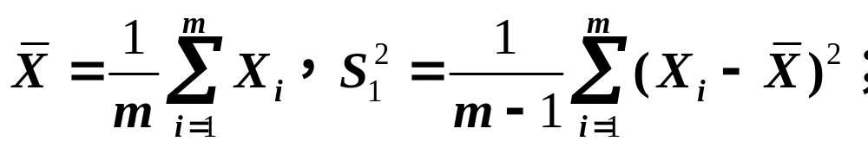


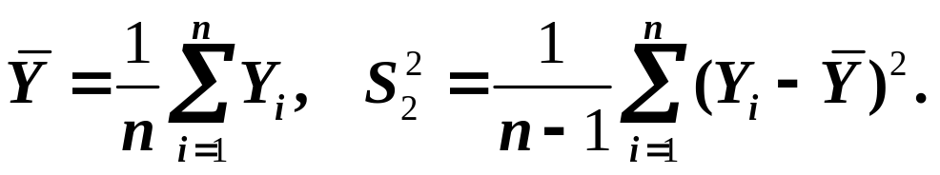
7.3.3 Confidence intervals
of two Normal Distributions
Theorem 7.3.1
Suppose is a sample from .
The sample mean and sample variance are
Suppose is a sample from .
The sample mean and sample variance are
If they are independent of each other, then

Slide 5
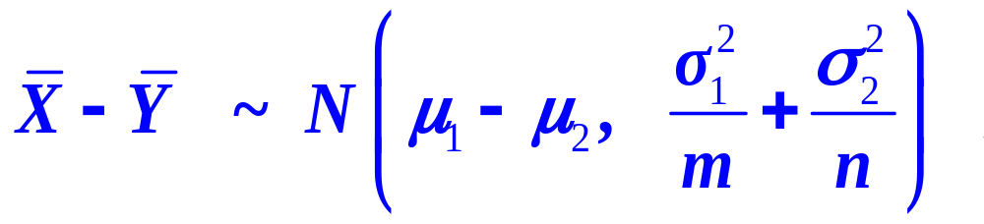

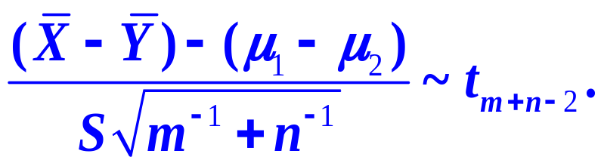
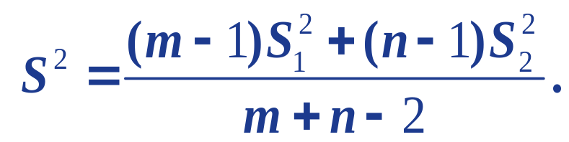
7.3.3 Confidence intervals
of two Normal Distributions
1
2
If is unknown,
where

Slide 6

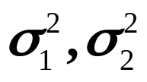
7.3.1 Confidence intervals for the mean
of a Normal Distribution
Question
Find the confidence interval for μ₁-μ₂ with confidence level
1
are known;
2
are unknown;

Slide 7
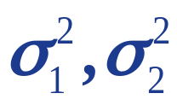
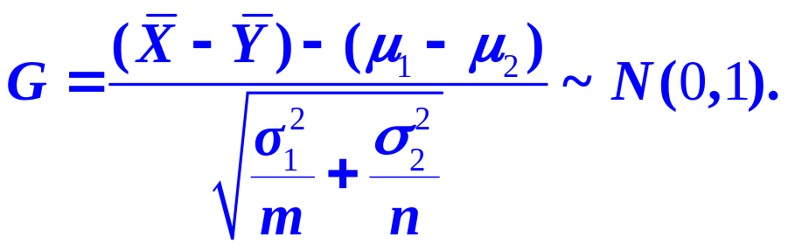

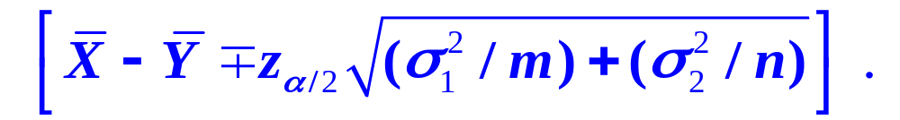
7.3.3 Confidence intervals
of two Normal Distributions
Question
Find the confidence interval for μ₁-μ₂ with confidence level
1
are known.
so the confidence interval for μ₁-μ₂ with confidence
level is:

Slide 8
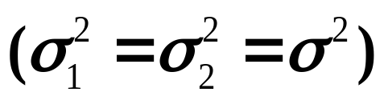
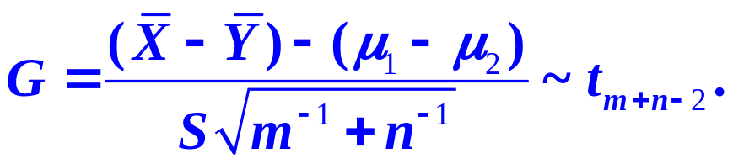
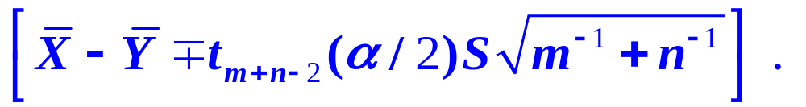
7.3.3 Confidence intervals
of two Normal Distributions
2
are unknown.
so the confidence interval for μ₁-μ₂ with confidence
level is:
where

Slide 9
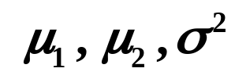

7.3.3 Confidence intervals
of two Normal Distributions
Example 1
Measure gravity constant by golden ball and platinum ball.
Suppose the gravity constant by golden ball X ～N(μ₁, σ²),
Observations measured by the golden ball:
6.683, 6.681, 6.676, 6.678, 6.679, 6.672
Suppose the gravity constant by platinum ball Y ～N(μ₂, σ²),
Observations measured by the platinum ball:
6.661, 6.661, 6.667, 6.667, 6.664
are both unknown.
Find the confidence interval of
with confidence
level 0.9.

Slide 10
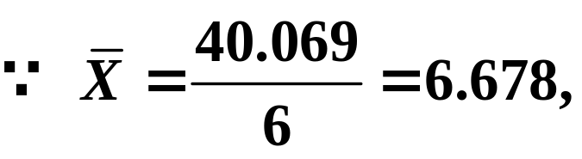
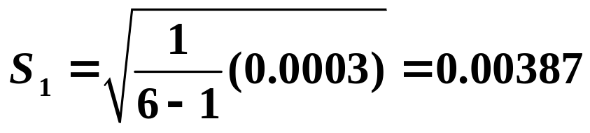


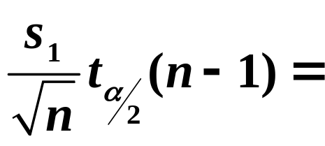
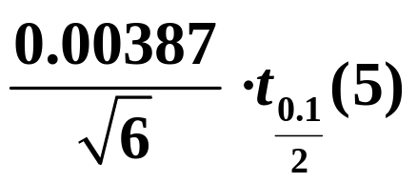
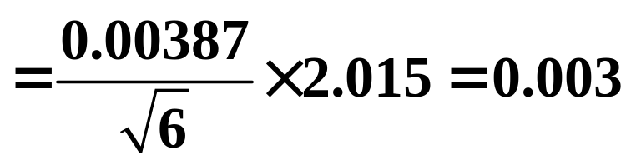

7.3.3 Confidence intervals
of two Normal Distributions
Solution:
also,
,that is:
So the confidence interval of with confidence level 0.9 is:

Slide 11
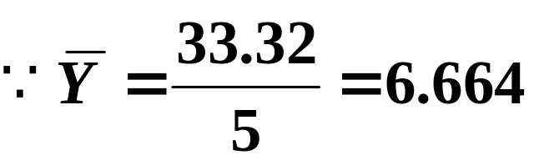
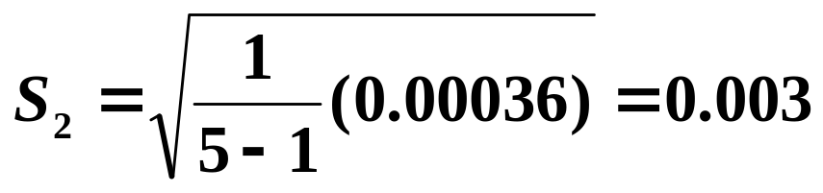
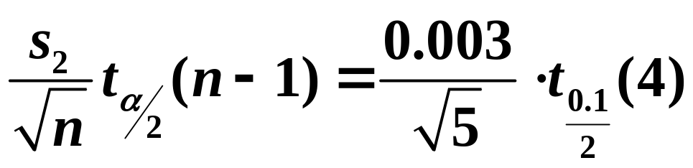
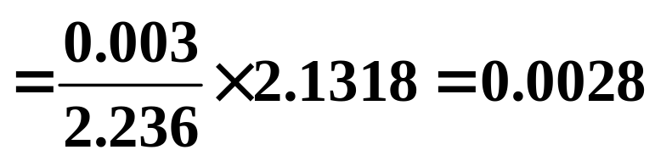

7.3.3 Confidence intervals
of two Normal Distributions
So the confidence interval of with confidence level 0.9 is:

Slide 12
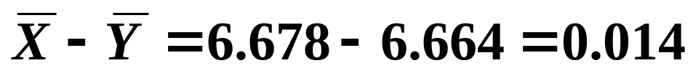

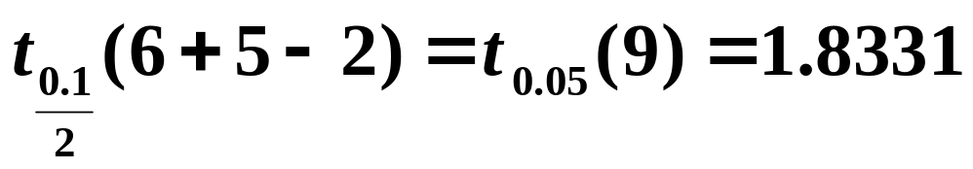

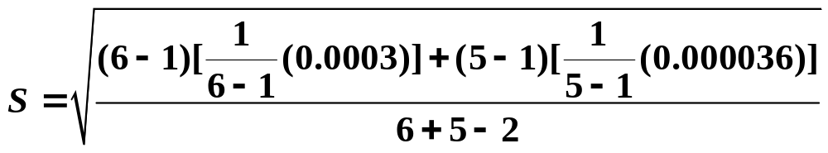

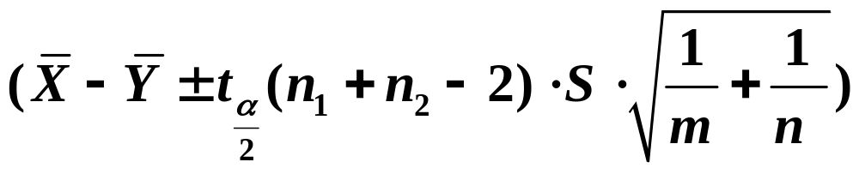

7.3.3 Confidence intervals
of two Normal Distributions
In general,if the confidence interval of includes 0, then we think there is is no significant difference between the two sample means;
so the confidence interval of
with confidence
level 0.9:

Slide 13
Chapter 8. Hypothesis Test
8.1 Basic Concepts
8.2 Test about the mean of normal distribution
8.3 Test about the variance of normal distribution

Slide 14
Contents
8.1 Basic Concepts
The basic idea of hypothesis testing
The basic idea of hypothesis testing
8.1.1
The foundation of hypothesis-deciding
8.1.2
Two types of errors in hypothesis testing
8.1.3

Slide 15


8.1.1 The basic idea of hypothesis testing
Example
In order to estimate the weight of a product, we measure
it 10 times:
10.l, 10.0, 9.8, 10.5, 9.7, l0.l, 9.9, 10.2, 10.3, 9.9.
Suppose the population to be tested follows
Can we judge the mean weight of the product is μ =
How to judge the validity of the assumption?

Slide 16
Contents
8.1 Basic Concepts
The basic idea of hypothesis testing
8.1.1
The foundation of hypothesis-deciding
The foundation of hypothesis-deciding
8.1.2
Two types of errors in hypothesis testing
8.1.3

Slide 17
8.1.2 The foundation of hypothesis deciding
The small probability event is almost impossible to happen in one trial.

Slide 18
Contents
8.1 Basic Concepts
The basic idea of hypothesis testing
8.1.1
The foundation of hypothesis-deciding
8.1.2
Two types of errors in hypothesis testing
Two types of errors in hypothesis testing
8.1.3

Slide 19




8.1.2 The foundation of hypothesis deciding
1
type 1 error (abandon the reality):
is correct, but it is mistakenly denied .
2
type 2 error (accept the false one):
is false, but it is accepted mistakenly.
If the probability of committing these two types of errors
are respectively:
P {deny | is true} =
P { accept | is false} =
so is the probability of type 1 error.
is the probability of type 2 error.

Slide 20
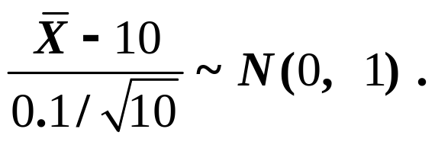
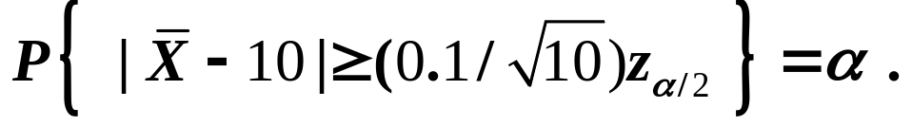
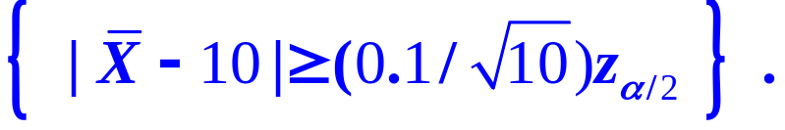
8.1.1 The basic idea of hypothesis testing
Example
In order to estimate the weight of a product, we measure
it 10 times:
10.l, 10.0, 9.8, 10.5, 9.7, l0.l, 9.9, 10.2, 10.3, 9.9.
Suppose the population to be tested follows
Can we judge the mean weight of the product is μ =10?
Solution:
H₀: μ =10
Region of rejection

